Slide 1


3RQ GAPS Assistance Program

Slide 2
What is GAPS?
Assistance program for grassroots organizations and small colleges.
  2023: Focused on grassroots organizations.
  2024: Expanded to small colleges/universities.
  2025: Under development.
Fills gap in funding to prepare for federal, state, and/or private grants leading to restoration projects.
Geared toward nonpoint source issues: acid mine drainage, sedimentation, etc.

Slide 3
Where does GAPS come in?
Create a Watershed Based Plan/Watershed Implementation Plan.
Collect representative data on pollution source/stream impacts.
Create rough pre-engineering plans and budget.
Apply for funding.
Typical Grant Preparation Process
Identify restoration project.
Good data is critical for successful projects!

Slide 4
Services Available
Services will vary for each awardee based on the needs of the specific project.
Direct services may include:
  Field Assistance or Training
    Grab sample and flow measurement collection
    Installation and management of in-stream data loggers
  Coordination with analytical laboratory
  Data management
  Grant searching and preparation
Funding may include:
  Analytical costs, travel, students
Notes:
Maximum ask: $10,000

Slide 5
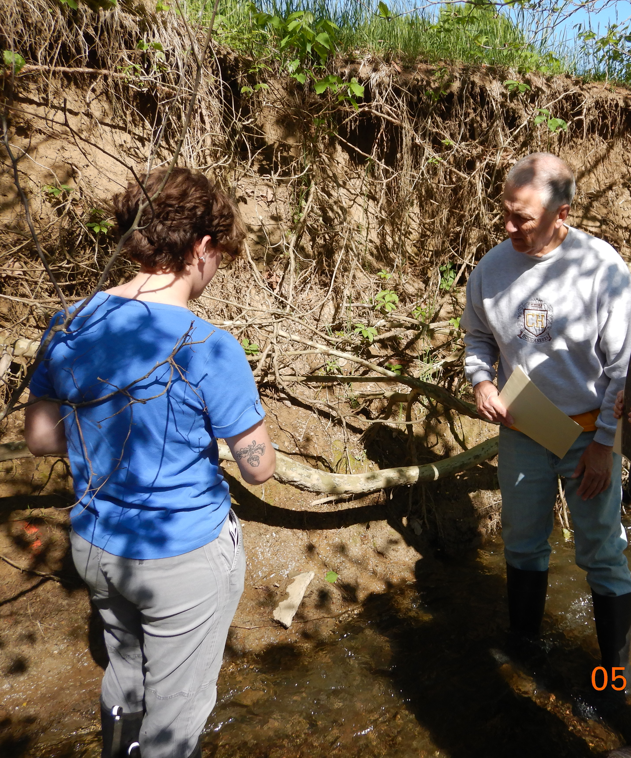
Additional Benefits
Data
  Uploaded to WATERS for long-term storage.
  Published to online maps.
Facilitate connections with state/federal agencies, researchers, and students.

Slide 6
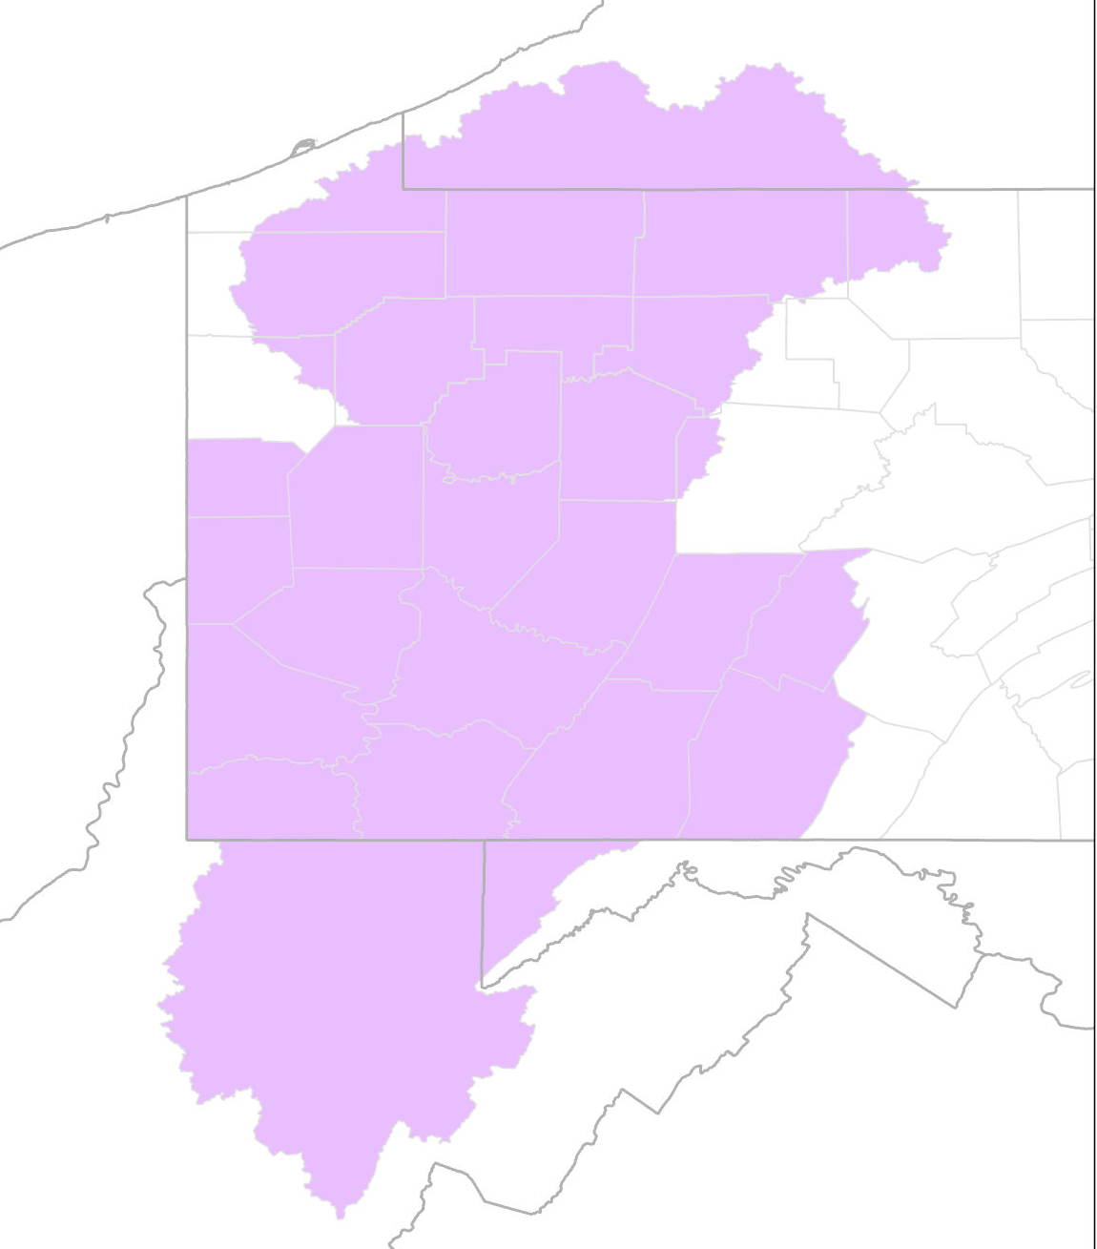
Eligibility
Project must be within:
  Monongahela River Basin;
  Allegheny River Basin; or
  Southwestern PA counties highlighted

Slide 7
Awarded GAPS Projects to Date
Upper Chartiers Creek Watershed Association – Houston Ball Field Erosion Study
Nine Mile Run Watershed Association – Commercial Street Culvert Monitoring Project
Chalfont Run/Thompson Run Watershed Association & Pitt Water Collaboratory – AMD Monitoring Study
Stream Restoration Inc. & West Wheatfield Township – West Wheatfield AMD Assessment
3 Rivers Waterkeeper – Targeted Sampling & Pollution Identification
Allegheny College Watershed Conservation Research Center – Woodcock Creek Monitoring Study
Mountain Watershed Association – Coal Run Watershed Study
University of Pittsburgh - Phillips Mine Discharge Study

Slide 8
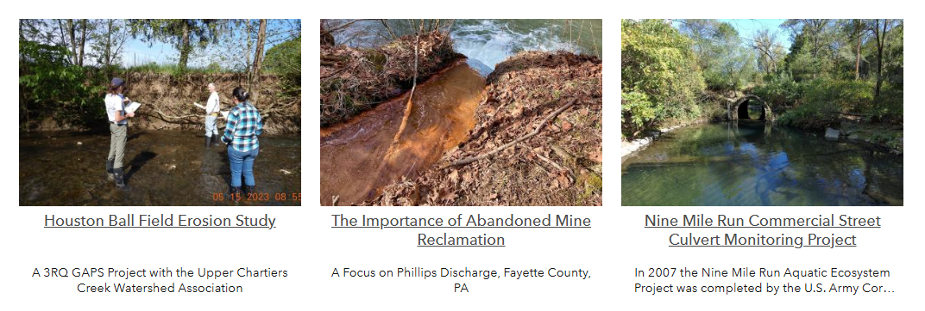
More information
3riversquest.wvu.edu/resources/gaps-assistance-program

Slide 9
Stay Connected
https://3riversquest.wvu.edu/
Facebook @3RiversQUEST
Biweekly E-newsletter 3riversquest.wvu.edu/news/rivers-run-through-this
Funded by

Slide 10
Contact
  rachel.spirnak@mail.wvu.edu
  melissa.oneal@mail.wvu.edu

